Slide 1
Cycle #1 – Family Earth Day – Science Night
Experiments 5:30-7PM
Raffle 7-7:15PM

Slide 2
Summary of Experiments – Cycle #1 - Family Science Night
1. Chemistry of Crime – Fingerprinting – Everyone has fingerprints and everyone’s fingerprints are slightly different. Students learn a very basic way to take their own fingerprints.
2. Chemistry of Crime – Hair Analysis - Everyone has hair. It seems so common. Yet, a single strand of hair at a crime scene can tell a lot about a person. A detective on the scene might ask the scientist: Was it the victims’ hair? Was it the suspects’ hair? What color is the hair? Is it animal hair and the victim does not have a pet? What kind of animal was it?
3. Chemistry of Energy - How Does Energy Work in Our Bodies? - Our bodies work on electrical current. The energy balls and sticks help show the current when the circuit is complete.
4. Chemistry of Energy – Energy takes many Forms - Steel spheres demonstrate potential (at rest) versus kinetic (in motion) energy and how energy disperses itself in many interesting ways!
5. Health & Wellness Interactive Demo – How much sugar is REALLY in that? – Students discuss the nutrition facts label (what is one it) and get a visual example of how much sugar a certain # of grams really is (example is that Coke has 39 grams of sugar per can)
6. Health & Wellness – Diabetes and You? - When you eat food, the food that you eat is stored and broken down into simpler sugars and used for energy. Sometimes, when we continuously eat too many sugary foods, our body isn’t able to continue to produce enough insulin to break down the food into sugars. These people develop diabetes. Diabetes among young students (even those in elementary/middle school!) is becoming a huge problem so being aware of what you are eating and how much you are eating is important. Students learn one way doctors test patients for diabetes.
7. Monster Snot! – The Chemistry of Polymers – Materials Experiment – Students learn about crosslinking of molecules by making slime.
8. Bouncing off the Wall – Super Balls – Materials Experiment – Students learn about crosslinking of molecules by making rubber.
9. Snap Circuits
Tip:
The goal is not to make them “learn” about the experiment, but to make them want to “ask more” about the experiment and to share your personal excitement for Science, Technology, Engineering and Mathematics process.
It is ok, and even important to show that we don’t know answers, we know how to find answers to our questions.

Slide 3
Summary of Items Needed for Cycle #1 Experiments:
1. Chemistry of Crime – Fingerprinting
a. Paper Fingerprint cards
b. Pencils
c. Fingerprint identification guide
d. Baby wipes/hand sanitizer
2. Chemistry of Crime – Hair Analysis
a. Several microscopes
b. Hair samples
c. Laptop for digital microscope
d. extension cord & outlet
3. Chemistry of Energy - How Does Energy Work in Our Bodies?
a. Energy sticks
b. Energy balls
4. Chemistry of Energy – Energy takes many Forms
a. Steel spheres
b. quarters of paper
c. quarters of aluminum foil
5. Health & Wellness Interactive Demo – How much sugar is REALLY in that?
a. Sugar cubes
b. Couple of common edible items (can of soda, bottle of soda, candy bar, granola bar)
c. Small scale
6. Health & Wellness – Diabetes and You?
a. Dip strips
b. Fake urine samples
c. Paper towels
7. Monster Snot! – The Chemistry of Polymers – Materials Experiment
a. PVA solution in 1-gallon jug
b. Borax solution in 1-gallon jug
c. Paper towels
d. Wooden sticks
e. Plastic cups
f. Ziploc bags
8. Bouncing off the Wall – Super Balls – Materials Experiment
a. Liquid latex in 1-gallon jug
b. Vinegar in 1-gallon jug
c. Paper towels
d. Wooden sticks
e. Plastic cups
f. Ziploc bags

Slide 4
Chemistry of Crime Fingerprinting
Experiment #1

Slide 5
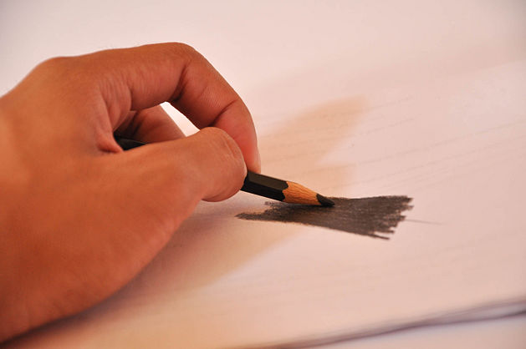
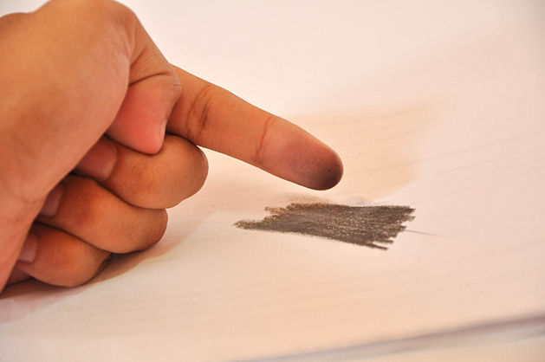
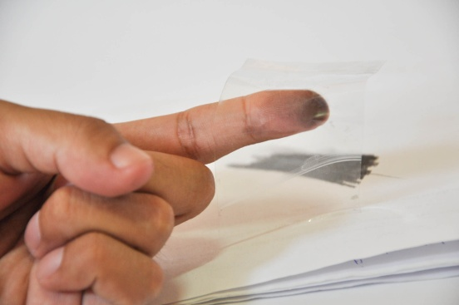
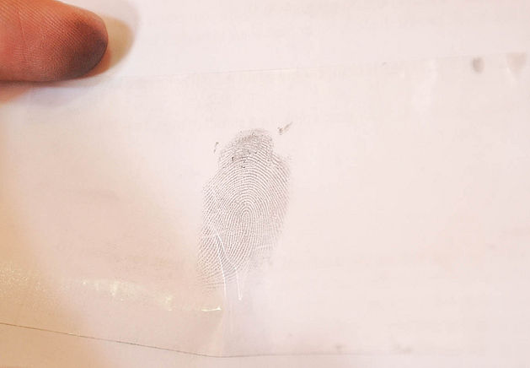
Family Science Night: Chemistry of Crime – Fingerprinting
Chemistry of Crime – Fingerprinting – Everyone has fingerprints and everyone’s fingerprints are slightly different. Students learn a very basic way to take their own fingerprints.
Supplies
a. Paper Fingerprint cards
b. Pencils
c. Fingerprint identification guide
d. Baby wipes/hand sanitizer
e. Scotch Tape
Latent (Hidden) Fingerprints
The oils on your skin leave a faint image of your fingerprint on everything you touch. Talcum or graphite powder sticks to the oils, and sellotape lifts talcum powder off the surface. This takes the fingerprint with it, and lets forensic scientists compare the fingerprint with “villainous” prints back in the lab.
Note: you can do this without scotch tape and just roll your finger across the paper
1. Rub the side of a pencil on a piece of paper
2. Rub your finger on the penciled area
3. Put Scotch Tape on your finger
4. Put Scotch tape on piece of paper
Talking Points (Ask the kids what they think about….)
What is a fingerprint? Are they unique?
What kind of surfaces have fingerprints on them(ie hard, soft, cloth, skin?)
What about your body chemistry might affect your fingerprint?
Ideas on what a “good” fingerprint vs “bad” fingerprint?
How do they compare from finger to finger? How do they compare to someone else’s?
How would computers, math and/or chemistry help with efficiency and accuracy of identifying print owners?
Notes:
http://science.pppst.com/forensics.html
http://www.creative-chemistry.org.uk/activities/fingerprinting.htm#Teacher notes

Slide 6
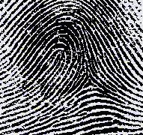
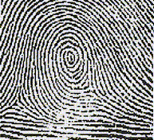
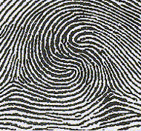
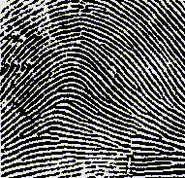
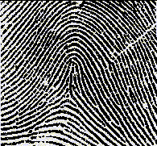
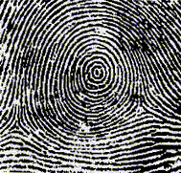
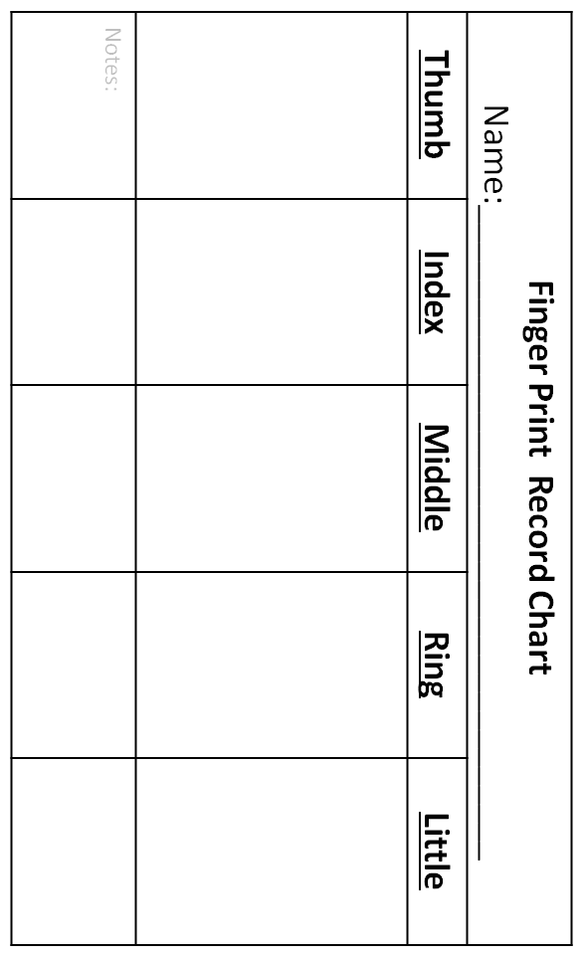
Loop
Central Pocket Loop
Double Loop
Plain Arch
Tented Arch
Plain Whorl
Fingerprint examination
Closely examine each fingerprint, and identify its pattern using the information sheets. Record this information on your chart.
Fingerprint examination
Closely examine each fingerprint, and identify its pattern using the information sheets. Record this information on your chart.

Slide 7
Chemistry of Crime Hair Analysis
Experiment #2

Slide 8
Family Science Night: Chemistry of Crime – Hair Analysis
Chemistry of Crime –Hair Analysis - Everyone has hair. It seems so common. Yet, a single strand of hair at a crime scene can tell a lot about a person. A detective on the scene might ask the scientist: Was it the victims’ hair? Was it the suspects’ hair? What color is the hair? Is it animal hair and the victim does not have a pet? What kind of animal was it?
Supplies
Chemistry of Crime – Hair Analysis
a. Several microscopes
b. Hair samples
c. Laptop for digital microscope
d. extension cord & outlet
Prior to talking to kids, read the information sheets provided for background
Talking Points (Ask the kids what they think about….)
Is all hair a like?
Is animal hair/fur like human hair?
How would it help solve a crime?
Is all hair alike?
Why is some curly and some straight?
What other occupations would need to know about hair?
(potential ideas: hair stylists, veterinarian, doctors, archeologists, artists (brushes), makeup artists, yourself)
Is chemistry important to know for working with hair?

Slide 9
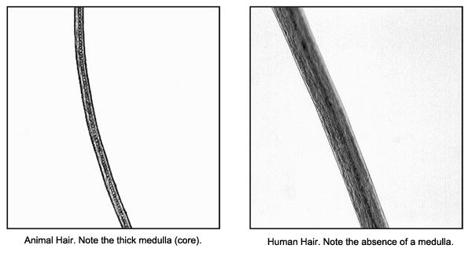
Family Science Night 2. Chemistry of Crime – Hair Analysis
Whether a hair is curly or straight, it is caused by chemistry– specifically, by the position of sulfur atoms in your hair molecules.
Hair is primarily composed of keratin, a protein. These proteins contain sulfur atoms which pair up and bond (disulfide bond). If the two sulfur atoms in the same protein are far apart, and join to form the disulfide bond, the protein will bend and hair will curl. .
Heat and low humidity produced by a hair dryer disrupt the structural bonds (particularly weak hydrogen bonds) enough to give hairs wounded around a roller some temporary curly aspect. However, this effect can be easily abolished by an increase in humidity or contact with water. Setting agents such as gel, hairspray and mousse provide support by coating hairs with a soluble resin.
People can temporarily alter their hair to force it into a straight state, or a curly state, but only on a temporary, not on a permanent, basis. When a straight-haired person gets a "permanent wave," known as a "perm," he or she is chemically forcing the making of strong disulfide bonds. The wave does not stay permanently, because new hair, which is straight, grows in as the "perm" grows out. People with curly hair may chemically alter their hair to give it a straighter appearance, but this, too, is also a temporary solution to a permanent "problem," with the same end result.
Identifying whether the hair is human or animal is the first step in forensic hair analysis. Human hairs usually have a thin (less than ⅓ of the hair’s diameter) or an absent medulla region. Animal hairs usually have thick medullae (more than ½ of the hair’s diameter). The core of animal hair is designed to protect the beast from cold or heat. Depending on the climate where the animal lives, it has a greater or lesser number of air filled alveoli which allow maintenance of almost constant temperature.
Hair goes gray because pigment cells in the hair base at the roots of the hair stop producing melanin. It doesn't matter if you are fair-haired or dark-haired you have the same chances of getting gray hair. However, it is more noticeable in darker haired people. The graying of hair appears to be genetically determined but the connection isn't at all clear.
Notes:
http://www.coolquiz.com/trivia/explain/
http://chemwiki.ucdavis.edu/

Slide 10
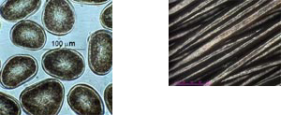
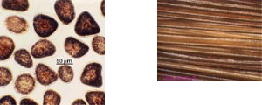
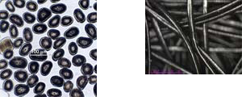
Family Science Night 2. Chemistry of Crime – Hair Analysis
58 to 100 microns - the diameter of a single hair. However, since the cross section of a hair is elliptical, the term diameter is not totally accurate . A micron is one millionth of a meter, or one thousandth of a millimeter - it therefore takes 10 to 20 hairs "piled up" together to obtain a thickness of one millimeter.
hair-science.com
Asiatic hair & cross section under video microscope
This shape is never completely circular. The cross-section of a hair is an ellipse which can tend towards a circle or be distinctly flattened. An analogy with other materials shows how this cross-section influences the appearance of the hair in space: on condition that sizes are much the same, a virtually flat ribbon rolls up much more easily than a cylindrical length of string.
Asiatic heads of straight hair are formed from almost round hairs which are moreover fairly fat.
Caucasian hair is variable and its cross section forms a accentuated ellipse, and range from straight, through wavy to very curly.
African hair has a flattened cross-section and is finer and can form tight circles with diameters of only a few millimeters.
hair-science.com
Caucasian hair & cross section under video microscope
hair-science.com
African hair & cross section under video microscope

Slide 11
Chemistry of Energy How Does Energy Work in Our Bodies?
Experiment #3

Slide 12
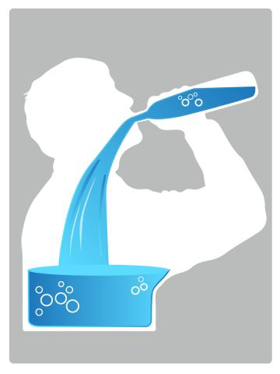
Family Science Night: Chemistry of Energy How Does Energy Work in Our Bodies?
4.. Chemistry of Energy – How Does Energy Work in Our Bodies... We need energy to live. How does energy get transported in our body? WATER! Our bodies are made up of ~60% water! But we need salts (electrolytes) to make the energy flow.
Let’s test how strong the energy flow is through our body.
Instructions and Talking Points
(Ask the kids what they think about….)
Before you begin:
Remember that a circuit is a loop… whether big or small… and connecting that loop, connects the circuit.
Experiment:
With one person holding the energy stick, connect the circuit.
Add in people and see how big the loop (the circuit) can be before energy transfer becomes challenging!
Add in a bowl of water (2 people touch the water and not each other’s hands) and see what happens!

Slide 13
Chemistry of Energy Potential versus Kinetic Energy
Experiment #4

Slide 14
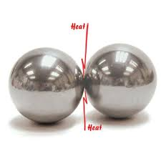
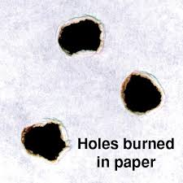
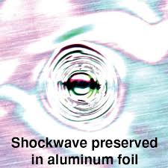
Family Science Night: Chemistry of Energy Energy takes many Forms - Steel spheres
4.. Chemistry of Energy – Energy takes many Forms... Steel spheres demonstrate potential (at rest) energy versus kinetic (in motion) energy and how energy disperses itself in many interesting ways!
Instructions and Talking Points
(Ask the kids what they think about….)
Before you begin:
Make observations about the steel spheres. Ask them if they know what a hypothesis is [a hypothesis is an educated guess about something that might happen … if we ‘smash’ the steel balls together what do you think will happen?]
Experiment:
With one person holding a piece of paper, smash the spheres together (carefully without smashing the person’s fingers). Make observations.
With one person holding a piece of aluminum foil, smash the spheres together (carefully without smashing the person’s fingers). Make observations.
When two 1-pound, 2-inch diameter, chrome steel spheres are smashed together, enough heat is generated at the point of contact to burn a hole in a piece of ordinary paper! This amazing demonstration graphically illustrates the conversion of mechanical energy into heat energy. Although there are no flames, a charred hole appears along with the odor of burnt paper. Likewise, when the spheres are smashed together with aluminum in the middle, a small but visible shock wave can be observed from the energy dissipation.

Slide 15
Health & Wellness
How much sugar is REALLY in that?
Experiment #5

Slide 16
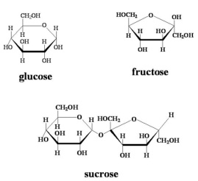
Family Science Night: Health & Wellness– How much sugar is REALLY in that
5. Health & Wellness Interactive Demo – How much sugar is REALLY in that? – Students discuss the nutrition facts label (what is one it) and get a visual example of how much sugar a certain # of grams really is (example is that Coke has 39 grams of sugar per can)
Instructions and Talking Points
(Ask the kids what they think about….)
Before you begin:
How many sugar cubes do you think are in a bottle of soda, etc?
From the label:
Number of servings in bottle:
Grams of sugar in one serving of soda: ____________g
(what is a gram? -introduce metric system )
Calculate & Count:
Number of grams of sugar in the bottle: ____________g
(Hint: number of servings in bottle x grams of sugar in a serving = grams of sugar in the bottle)
Count the number of sugar cubes in the weighing pan:__________
Report/Discuss:
Which was greater, the number of sugar cubes that you thought would be in the bottle of soda, or the number of sugar cubes that you weighed on the balance?
Can you find the many names of the sugars in the ingredients list?
Did you realize you were eating this much sugar?
Can knowing this help you make better choices in “spending” your sugar or calorie allowances?
5. Health & Wellness Interactive Demo – How much sugar is REALLY in that?
a. Sugar cubes
b. Couple of common edible items (can of soda, bottle of soda, candy bar, granola bar)
c. Small scale
Naturally occurring sugars, like those in fruits, are better for you than the processed sugars and syrups found in candy and soda.
There are many different sugars in the ingredients list. The names of most sugars end in –ose.
Commonly added sugars are sucrose, fructose and glucose. The name of the sugar found in milk is lactose.

Slide 17
Health & Wellness
Diabetes and You?
Experiment #6

Slide 18
Family Science Night: “Urine the Know”- Diabetes and You
6. Health & Wellness – Diabetes and You? - When you eat food, the food that you eat is stored and broken down into simpler sugars and used for energy. Sometimes, when we continuously eat too many sugary foods, our body isn’t able to continue to produce enough insulin to break down the food into sugars. These people develop diabetes. Diabetes among young students (even those in elementary/middle school!) is becoming a huge problem so being aware of what you are eating and how much you are eating is important. Students learn one way doctors test patients for diabetes.
6. Diabetes and You?
a. Dip strips
b. Fake urine samples
c. Paper towels
Talking Points (Ask the kids what they think about…)
When you go to the doctor when you’re sick, why do you think they ask you to pee in a cup?What do you think Urine can tell you about a person’s health? (color → hydration; too much glucose→ diabetes; contains protein→ kidney trouble?)
Urine testing, or urinalysis, is a quick way to see if certain chemicals are present in urine. (maybe ask someone to read directions on bottle out loud if appropriate)
What visual observations can you make about samples?
After doing the test, what did you learn about these samples? What does it mean?
What could / should the person consider if this was really their urine test results?
Experiment:
Hold the strip by the end opposite the felt pads and dip the strip into the cup –wetting the pad. Place strip onto its longest side on paper towel to dry any excess water remaining on the strip.
Watch the colors of the felt pads to see if they change. Compare the color on the pad for the test with the chart on the side of the bottle. Check the chart on the side of the bottle to see which pad shows which results.
Where’s the Chemistry?
The urinalysis test strips that you used in this activity use a mixture of several different chemicals that react with each other to change the color of the felt pad when glucose or protein is present. Because the test looks at how much the color changes, it is called a colorimetric” test. Colorimetric is a compound word, with the first part being “color”, and the root of second part being “meter”. Together, the word means color meter.

Slide 19
Monster Snot! – The Chemistry of Polymers
Materials Experiment
Experiment #7

Slide 20
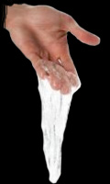
Family Science Night: Monster Snot
7. Monster Snot! – The Chemistry of Polymers – Materials Experiment – Students learn about crosslinking of molecules by making slime.
. Monster Snot! – The Chemistry of Polymers – Materials Experiment
a. PVA solution in 1-gallon jug
b. Borax solution in 1-gallon jug
c. Paper towels
d. Wooden sticks
e. Plastic cups
f. Ziploc bags
Squirt 1 pump of PVA solution into cup- have kids stir with wooden stick and describe
Squirt 1 pump of Borax solution into the cup- have kids stir with wooden stick and describe
The glue and water mixture contains long chains of a polymer called polyvinyl acetate. When you add the borax solution, it links the long polymer chains together, changing the liquid into a slimy glob.
Kids can take home the slime in the Ziploc bags.
Talking Points
(Ask the kids what they think about….)
What observations can you make?
Describe how the slime feels
Does the slime hold one shape?
Why do you think it behaves like it does?
Using “Snot” to describe crosslinking in chemistry” If you take a handful of uncooked spaghetti and push anywhere, those pieces of spaghetti move. Now cook the spaghetti. It becomes a tangled mess and it is much harder to move one strand without the others pulling on it, trying to keep it from moving (or moving along with it). Using this principle of crosslinking, you can tune a fairly large set of parameters to make a polymer material as hard, soft or elastic as you want it to be
Using “Snot” to describe how Mucus : Our bodies defend themselves in many different ways to prevent us from getting sick. One way our noses keep allergens like pollen, spores, and dust out of our lungs is with a sticky, slimy substance called mucus. When you breathe air in through your nose, allergens like pollen and dust get stuck in the mucus and become trapped. In this activity, you will make a slimy substance very similar to mucus.
A polymer is a large molecule, often containing thousands of small molecules joined together chemically to form one giant macromolecule.

Slide 21
Bouncing off the Wall – Super Balls – The Chemistry of Polymers
Materials Experiment
Experiment #8

Slide 22
Family Science Night: Bouncing off the Wall
8. Bouncing off the Wall – Super Balls – Materials Experiment – Students learn about crosslinking of molecules by making rubber.
8. Bouncing off the Wall – Super Balls – Materials Experiment
a. Liquid latex in 1-gallon jug
b. Vinegar in 1-gallon jug
c. Paper towels
d. Wooden sticks
e. Plastic cups
f. Ziploc bags
WARNING:
Beware of LATEX Allergies!
Talking Points
(Ask the kids what they think about….)
What observations can you make? (just the latex)
What observations can you make? (just the vinegar)
How the congealed mixture feels?
Does it bounce?
Why do you think it behaves like it does?
What do you think the term “elastic” or “elastomer” means
What do you think Cross Linking means?
Squirt 1 pump of liquid latex into cup- have kids stir with wooden stick and describe
Squirt 1 pump of vinegar into the cup- have kids stir with wooden stick and describe
Remove congealed mixture from cup and roll in hands to form a ball
liquid latex mixed with water and acid to make it thicker. This process is called coagulation. Mixing latex with vinegar (acetic acid) will cause the latex to solidify into rubber very quickly. Rubber is a specific type of polymer called an elastomer: a large molecule that can be stretched to at least twice its original length and returned to its original shape

